Slide 1

USID OUTAGE IMPACT ASSESSMENT FRAMEWORK
Goal: Assess the impact of shutting down one target USID in a target area.
User-Centric: Prioritize user-facing impact over radio-only degradation.
User-Centric Network Reliability
Integrated: Combine USID dominance, attribute analysis, and regional data.
Output: Deliver severity ratings, impact levels, and detailed reasoning.

Slide 2
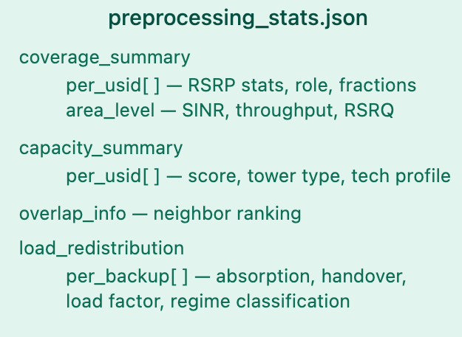
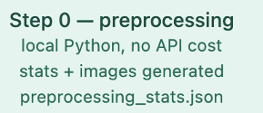
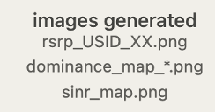
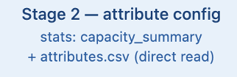
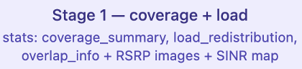
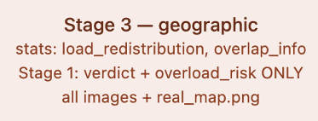
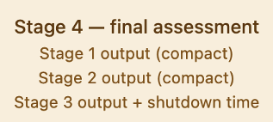
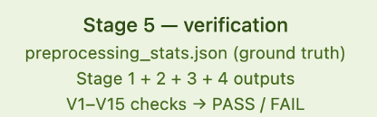
OVERALL PIPELINE
Attribute.csv
Rhea Data
Real map

Slide 3
From Prompt Engineering to Harness Engineering
Harness Engineering
Prompt Engineering
Context Engineering
Control how the system executes
Tell the model what to do
Give the model the right information
Enable reliable multi-step workflows
"The bottleneck shifts from input design to execution control"

Slide 4
What is Harness Engineering?
"Harness Engineering is the design of the execution system around an LLM"
Model + Harness = whole system
Not just providing information, but controlling execution
Orchestration
Execution Modules
Verification & Control
State & Memory
•
Predefined workflows
•
Specialized agents or tools
•
Validation and evaluation
•
Intermediate results
•
Dependency management across steps
•
Each handles a specific subtask
•
Error detection and correction
•
Persistent storage (e.g., logs or memory systems)
"A harness turns an LLM into a reliable system"

Slide 5

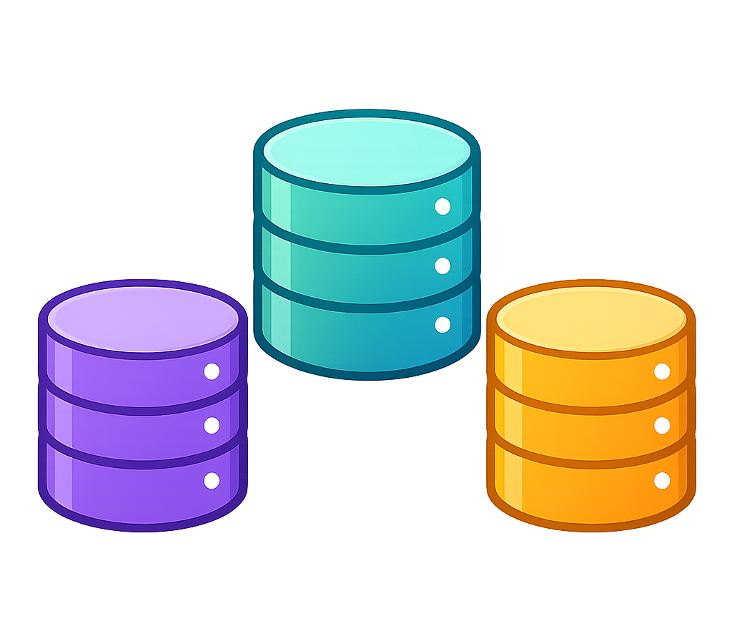
System design: hard-coded orchestration
Target USIDs, shutdown duration
Harness
Orchestrate & dispatch agents
Enforce verification & rerun logic
Input tickets
Prompt parser
Output result
preprocess
Analysis agents
KPI analysis agent.
Coverage & load agent
Attribute analysis agent
Verification agent
Run-store MCP server
Verification agent
Geo-correlation agent
Verification agent
Per-agent skill file Injected by harness to each agent
Skills library
Verification agent
Final assessment agent
Verification agent
Verification & reflection agents
Rules-memory MCP server
Cross agent verifier
Reflector
agent
Notes:
Comment: should we add planner?

Slide 6
System design: execute planner (demo mostly done)
Target USIDs, shutdown duration,
Outage type
Input tickets
Prompt parser
Execute Planner
Skills library
Harness
Orchestrate & dispatch agents
Enforce verification & rerun logic
Output result
Per-agent skill file Injected by harness to each agent
preprocess
Run-store MCP server
Analysis agents
Skill planner is an agent that can retrieve data from MCP server, and together with the tickets information, it can create skills for all the agents, it can dynamically tailors each agent's instructions based on the specific outage context.
KPI analysis agent.
Coverage & load agent
Attribute analysis agent
Verification agent
Verification agent
Geo-correlation agent
Verification agent
Verification agent
Final assessment agent
Verification agent
Verification & reflection agents
Rules-memory MCP server
Cross agent verifier
Reflector
agent

Slide 7
System design: Global planner
Target USIDs, shutdown duration,
Outage type
Input tickets
Prompt parser
global Planner
Skill writing agent
Analysis agents needs
Orchestration of these agents
Harness
Make sure the execution follow the orchestration, force the verification for each planned agent
Skills library
Run-store MCP server
Output result
Global planner plan for what is the analysis agents, and how they work together. It will also give instructions for skill writing agent to write the full skill.
Analysis agents
Verification & reflection agents
Rules-memory MCP server
Cross agent verifier
Reflector
agent
Notes:
Planner and orchestration difference.
Who should do the further analysis. (should we do the further analysis?, hard to enumerate all the situation, what then?)
Next week plan:
1.

Slide 8
plan next week
Finish the demo for the execute planner.
Finish the demo for the global planner.
Finish the demo for the basic design (version 1)
Notes:
Planner and orchestration difference.
Who should do the further analysis. (should we do the further analysis?, hard to enumerate all the situation, what then?)
Next week plan:
1.

Slide 9
Context Planner — What Is the Outage Scenario?
Converts a semi-structured ticket into a shared analysis contract and per-agent control flags. Decides which data is needed and which should not be used.
Q1 Which sectors are failed / degraded / active?
If ticket names sectors → uses ticket directly (ticket_declared).
If not named → calls get_kpi_history for baseline, then get_kpi_timeseries to observe actual throughput during outage window. Classifies: < 5% baseline = failed · 5–60% = degraded · > 60% = active.
Output →
sector_states: { S0: failed, S1: active, S2: failed }
Q2 Does this outage overlap the station's recurring peak hours?
Always calls get_kpi_history. Aggregates 60-day throughput by hour-of-day to find station-specific peak hours (not inferred from ticket timestamp). Checks overlap with outage window.
Output →
peak_overlap: true · peak_hours: [17:00, 18:00, 19:00, 20:00]
Q3 What is the geographic scope of impact?
Pure inference — no tool call. Full Outage → FULL_SITE_COVERAGE_LOSS. Failed sector present → PARTIAL_COVERAGE_LOSS. Degraded only → null. Sets Geo Agent's analysis scope.
Output →
geo_scope_flag: PARTIAL_COVERAGE_LOSS
Q4 What is the time background and surrounding land-use profile?
Derives day_type (holiday / weekend / weekday) and time_of_day from outage_start_utc. Calls get_area_profile(lat, lon) to get OSM land-use data. Passed to KPI Agent for traffic forecast calibration.
Output →
day_type: weekday · dominant_landuse: residential
Planner output → shared_context (all agents read) + per_agent_context (each agent's priority_focus, flag, constraint)

Slide 10
Skill Design — Planner Flags Control Which Skills Load
Each agent has a base skill that always runs, plus optional extension skills triggered by Planner flags. Agents only do extra analysis when the outage actually calls for it.
Coverage Agent
BASE (always loads)
IF FULL_SITE_FAILURE or PARTIAL_SECTOR_FAILURE
coverage_analysis_base.md — always runs
Evaluates whether neighbors can provide backup signal for the affected area. Reads preprocessing RF stats and RSRP images.
→ loads coverage_directional_focus.md
Queries pixel coordinates per sector; computes centroid and bounding box so Geo Agent gets a precisely-centered map for each affected direction
KPI Agent
BASE (always loads)
IF peak_overlap = true AND duration ≤ 6h
kpi_analysis_base.md — always runs
Forecasts traffic-layer pressure using historical KPI only. Selects historical analogs, applies absorption fractions, compares to p90.
→ loads kpi_peak_hour_analysis.md
Re-evaluates pressure using only peak-hour historical data — prevents full-window average from masking worst-case short burst
IF duration > 6 hours
→ loads kpi_sustained_pressure.md
Hour-by-hour pressure trajectory — detects whether stress persists, concentrates at peak, or degrades over time
attribute / Geo / final Assessment
BASE (always loads)
No conditional extensions
config_analysis_base.md · geo_analysis_base.md · assessment_agent.md — single skill each, no extensions.
Config reads hardware attributes; Geo reads real OSM map tiles; Assessment synthesizes all specialist outputs.

Slide 11
Five Specialist Agents — Each Answers One Question
Coverage
KPI
attribute
Geo
Assessment
Signal Layer
Traffic Layer
Hardware Layer
Geographic Layer
Final Verdict
Can users still get backup signal?
Can neighbors carry the displaced traffic?
Does the hardware actually support absorption?
What kind of place lost coverage?
What is the final severity, overall?
How:
How:
How:
How:
How:
Read preprocessing outputs: RSRP statistics, coverage hole fraction, absorption fractions,…
Reads 4G/5G cells, bands, tower type, operational role
Requests real map tiles centered on each affected sector centroid
Reads all four specialist artifacts
Historical-only forecast, Build historical forecast candidates: same-hour mean, p75, p90, same-daytype mean, recent trend, and peak-hour candidate
Inspect RSRP/SINR images to describe spatial signal patterns relative to the target coverage boundary.
Applies feasibility rules; flags NSA 5G downgrade risk
Visually identifies land use from map features only
Applies P1/P2/P3 rules; applies geo escalation override
Apply coverage-derived absorption fractions to estimate neighbor load and classify pressure against p90 references.
Evaluate backup signal quality with the statistics
Classifies capacity pressure: low / moderate / high / critical
Reasons about micro station physical reach limitations
Links coverage holes to terrain features; sets sensitivity flags
Explains conflicts between agents; considering uncertainties around each agent.
Produce spatial findings for Geo Agent: coverage holes, weak zones, strong zones, and affected directions.
Why LLM:
Why LLM:
Why LLM:
Why LLM:
Why LLM:
Visual RSRP map interpretation and spatial signal pattern description cannot be hard-coded
Choosing the right historical analog based on time and land-use context requires contextual judgment
Static attributes must be interpreted in the specific outage context.
Map image interpretation and spatial terrain-hole correlation require visual reasoning
Multi-layer conflicts (Coverage adequate vs KPI critical) cannot be resolved by lookup — require conflict characterization
Coverage / KPI / Config run in parallel · Geo waits for Coverage centroids · Assessment reads all four
Notes:
Each agent more flexible: database, knowledge base, question.

Slide 12
Demo — Ticket Input: TKT-2026-04-17-0002
📋 TKT-2026-04-17-0002 · RESOLVED
Planner agent output
Station
USID_09
Outage type
Partial — S1 remains active; S0 and S2 are fully down
Type
Partial Outage
Duration
Failed
Sectors S0, S2
10.46 hours, covering 4 peak hours (17:00–20:00 UTC)
Active
Sector S1
Peak hours within window
“17:00", "18:00", "19:00", "20:00"
Start (UTC)
2026-04-17 10:31
Land use
End (UTC)
2026-04-17 20:59
No school, commercial, railway
Duration
10.46 hours
Location
Plano, TX 75025
Near
Bob Woodruff Park
Root Cause
Hardware fault

Slide 13
Demo — Coverage & KPI Results (TKT-2026-04-17-0002)
Coverage Agent
KPI Agent
✓ ADEQUATE
Can users still get backup signal?
BASE
SUSTAINED
PEAK
Evidence
high → critical
unsustainable
critical
preprocessing stats: hole_fraction=0.0238, all backup handover_quality=good, RSRP p50 above −68 dBm for all backups
Forecast selection (reasoning):
Base case: same_daytype_same_hour_mean → 144.68 Mbps (weekday same-hour demand exceeds 60d mean) Stress case: same_hour_60d_p90 → 171.89 Mbps (outage overlaps peak hours)
How answered
Evaluated failed sectors only (S0, S2). USID_25 primary backup for both S0 and S2 (rsrp_p50=−64.8 dBm, sinr=mostly_mild). No weak zones identified.
Coverage hole
Neighbor pressure:
Single pixel at tower/park boundary — small and localized, not a broad service-loss region. Not a systemic gap.
USID_01, 25:
High, critical
USID_29, 45:
moderate moderate
Spatial output
USID_43:
High, high
USID_10:
low moderate
per_zone: S0 centroid (33.027, −96.694), S2 centroid (33.025, −96.696). Passed to Geo Agent for precise map targeting.
Sustained: 11/11 outage hours capacity risk in both base and stress — pressure never eases Peak hours (17–20h): all four peak hours capacity risk → peak_hour_verdict = critical
Reasoning value
Visual RSRP map interpreted to describe signal spatial pattern per direction
Key: This is a traffic pressure signal, not RF failure. Forecast uses historical analogs only — never outage-window neighbor data.

Slide 14
Demo — Config, Geo & Final Assessment (TKT-2026-04-17-0002)
Config Agent
Geo Agent (Real Maps)
Assessment Agent
ADEQUATE
lower_confidence
What kind of place lost coverage?
What is the final severity?
with constraints
Evidence
maps tiles centered on S0 centroid (33.027, −96.694) and S2 centroid (33.025, −96.696) — not the tower
P2
Does hardware support absorption?
Evidence
S0 sector
(2 pixels)
Green shaded area + park label → forest (Bob Woodruff Park). user_relevance = low.
Capacity scores, bands, operational roles from site attributes
confidence = medium
How
S2 sector
(30 pixels)
Regular street grid + smaller buildings → residential, suburban. user_relevance = high.
How
USID_25: score=0.78, capacity-oriented → feasible (Rule 1). USID_01/43/29/10: mixed role → marginal. USID_45: score=0.26, 4G-only → infeasible.
Reads all four specialist outputs. Applies P1/P2/P3 rules in sequence.
Coverage hole
Single pixel at tower/park interface — not a broad residential impact. Bulk of S2 is residential.
P1 not triggered
Constraint
Coverage=adequate, geo_escalation=false. No two critical conditions met simultaneously.
USID_25 is sole feasible neighbor but is a 20m micro tower. Physical coverage reach must be validated against Coverage per_zone before treating it as primary absorber.
P2 triggered
Self-flags
terrain_attenuation_active = false · high_sensitivity_area = false (no hospital or school found)
sustained= capacity risk (11/11 hrs, both base+stress) + NSA 5G downgrade risk flagged.
5G risk
Core conflict
USID_45 is 4G-only → users routed there lose 5G service. NSA 5G downgrade flagged (affected_fraction=0.01).
Key insight
Primary backups USID_01 and USID_25 sit in/near park territory → lower native load than KPI model assumes → actual headroom may exceed forecast
Coverage=adequate vs KPI=critical. Geo explains why: backup towers in low-load park area, so RF looks fine but traffic pressure is real.
Confidence
Medium — Coverage and KPI point in different directions. KPI estimate carries uncertainty (p90 proxy, forest neighbors).

Slide 15
Verification & Reflection — Quality Control and Learning
Per-Agent Verifier
Reflector + Memory Store
Question: Is each agent's reasoning internally consistent and are its assumptions appropriate for this scenario?
What does this run teach us about recurring patterns and prediction accuracy?
Coverage
pass
verdict_scope = failed_sectors_only ✓ · per_zone exists for S0, S2 ✓
Ground Truth
Predicted P2 · Actual P2 (hardware fault resolved 10.5h) → CORRECT
Memory Store: 5 entries total · 1 validated · 1 correct prediction
Config
pass
Feasibility rules applied correctly ✓ · micro-site limitation documented ✓
Geo
pass
Lessons this run:
Land-use from map evidence ✓ · no unsupported infrastructure flag ✓
KPI
FAIL
Coverage/KPI conflict is recurring for this site
Risk note described the forecast without clearly framing it as an estimated capacity-pressure
Spatial proxy (post_load_factor low) and KPI forecast (pressure high on USID_01/25) consistently diverge. Pattern recorded for future interpretation.
Cross-Agent Verifier
kpi_config labeled config_or_software_bottleneck
Hardware capacity OK but KPI forecasts exceed p90. Now confirmed pattern — not a one-off. Does not require HITL.
Do agent outputs agree across layers — and what action follows disagreement?
Rerun path confirmed
First-pass major conflict → KPI rerun with discrepancy note. HITL reserved for persistent conflict after retry. This is the expected control-flow path.
🔴
Coverage ↔ KPI:
MAJOR — signal_capacity_conflict
P2 prediction accuracy strengthened
⚠
KPI ↔ Config:
minor — config_or_software_bottleneck
P2 correct across multiple runs for Partial Outage + suburban + hardware fault pattern. Confidence in this pattern type increased.
✓
Coverage ↔ Geo:
consistent
✓
Geo ↔ Assessment:
consistent
✓
→ RERUN triggered: KPI Agent re-runs with discrepancy note injected into prompt. If still major after retry → HITL.
Assessment logic:
consistent

Slide 16
Verifier: LLM as a judge
Per-Agent Verifier
Reflector + Memory Store
Question: Is each agent's reasoning internally consistent and are its assumptions appropriate for this scenario?
What does this run teach us about recurring patterns and prediction accuracy?
Coverage
pass
verdict_scope = failed_sectors_only ✓ · per_zone exists for S0, S2 ✓
Ground Truth
Predicted P2 · Actual P2 (hardware fault resolved 10.5h) → CORRECT
Memory Store: 5 entries total · 1 validated · 1 correct prediction
Config
pass
Feasibility rules applied correctly ✓ · micro-site limitation documented ✓
Geo
pass
Lessons this run:
Land-use from map evidence ✓ · no unsupported infrastructure flag ✓
KPI
FAIL
Coverage/KPI conflict is recurring for this site
Risk note described the forecast without clearly framing it as an estimated capacity-pressure
Spatial proxy (post_load_factor low) and KPI forecast (pressure high on USID_01/25) consistently diverge. Pattern recorded for future interpretation.
Cross-Agent Verifier
kpi_config labeled config_or_software_bottleneck
Hardware capacity OK but KPI forecasts exceed p90. Now confirmed pattern — not a one-off. Does not require HITL.
Do agent outputs agree across layers — and what action follows disagreement?
Rerun path confirmed
First-pass major conflict → KPI rerun with discrepancy note. HITL reserved for persistent conflict after retry. This is the expected control-flow path.
🔴
Coverage ↔ KPI:
MAJOR — signal_capacity_conflict
P2 prediction accuracy strengthened
⚠
KPI ↔ Config:
minor — config_or_software_bottleneck
P2 correct across multiple runs for Partial Outage + suburban + hardware fault pattern. Confidence in this pattern type increased.
✓
Coverage ↔ Geo:
consistent
✓
Geo ↔ Assessment:
consistent
✓
→ RERUN triggered: KPI Agent re-runs with discrepancy note injected into prompt. If still major after retry → HITL.
Assessment logic:
consistent

Slide 17
Plan Regarding September Due
Update the overall design and finish the demo up to the analysis agents.
Todo: Finish the Demo for the whole system
Todo: using the real data to do the test and slightly adjust the system (adding reference-document in skill library, adjust tool library)
Notes:
Planner and orchestration difference.
Who should do the further analysis. (should we do the further analysis?, hard to enumerate all the situation, what then?)
Next week plan:
1.

Slide 18
System design: updated framework
Harness
Orchestrate agents |Enforce verification & rerun logic
Input tickets/text
Execute Planner
Plan Verification agent
Skills, can load documents, and have skill.md to guide the agent read the document and get the output
Task/tools assigned for each data-agent
Analysis agents
Skills library (reference document)
KPI analysis agent.
Attribute analysis agent
Coverage & geo agent
Verification agent
Tool library
Verification agent
Verification agent
Python functions, Tools (for computing numerical and rule-based functions) recommended by the planner, and will be called by the data agents
Run-store MCP server
Final assessment agent
Verification agent
Output result
Verification & reflection agents
Cross agent verifier
Rule-based cross verifier (python)
Reflector
agent
Ground truth

Slide 19
Planner: Task Decomposition
INPUT — Raw input
OUTPUT — Per-agent assigned task
(ticket)_id: Unique ticket/task identifier
For each agent, Planner produces:
Task (question for data agent): Specific to usid, data type, outage_type, time window, sectors
usid: Affected base station
outage_type: Full Outage / Partial Outage
recommended_tools: Suggested subset from Tool Catalog (not mandatory)
start_utc / end_utc: Outage time window
planner_reasoning: 2-3 sentences explaining the framing
affected_sectors: Sector list or null
PROCESSING — What Planner does
Understands outage semantics: type, scope, affected sectors, time window
Decomposes overall goal into 3 targeted sub-questions (one per data agent)
Assigns recommended tools per agent from the Tool Catalog

Slide 20
Planner Evaluator: LLM as a Judge
4 Evaluation Dimensions
Threshold
(can be tested by experiment or make to be adjustable)
Is the task decomposition high-quality and appropriately tooled?
1
Goal Alignment
≥ 0.8
Sub-questions collectively address the outage assessment goal
2
Completeness
≥ 0.8
Sub-questions cover all key impact dimensions (coverage, traffic, config)
3
Specificity
≥ 0.8
Questions are specific to this ticket's usid / outage_type / time window
4
Tool Appropriateness
≥ 0.8
Recommended tools match each sub-question's analytical needs
→ If FAIL: Harness retries Planner once. Still failing → pipeline aborts and flags for manual review.

Slide 21
Data Agent: Execution Design
INPUT — dynamic context injected by Harness
<analysis> — Minimal structured output
assigned_question · recommended_tools · ticket_parsed · skill.md · reference_document.pdf
Only the minimum structure needed for downstream agents
Skill.md: Tells the agent who it is, what tools are available, and that output must follow the <thinking> + <analysis> structure. Contains no analysis rules and no specific question — those are injected dynamically by the Planner at runtime.
Reference_document: can add more domain knowledge
conclusion free text answer to assigned_question
severity low | moderate | high
<thinking> — Completely free-form reasoning
confidence low | medium | high
Interpretation of assigned_question...
Plan: step 1 → query coverage pixels, step 2 → compute RSRP summary...
[tool_call] compute_coverage_summary → rsrp_mean = -96.3 dBm ...
[tool_call] identify_neighbors → primary backup: USID_14 (overlap 0.41)...
[extra_tool] get_area_profile → reason: RSRP map shows dense cluster,
need land-use confirmation before flagging sensitive area
[reasoning] RSRP gap 18 dB → hard replacement. Backup load 0.83 → high risk.
key_findings agent decides how many and what
tools_used all tool names actually called
extra_tools [{tool, reason}] — tools beyond recommended
flags.unresolved [{type, description, attempted, impact}]
flags.unresolved types: inference_gap (logical gap in data) or inquiry_drift_risk (question scope exceeded) — Ref: SAUP, Zhao et al. ACL 2025
Evaluator reads <thinking> to assess: Plan Quality · Plan Adherence · Logical Consistency · Execution Efficiency

Slide 22
Sub-Agent Evaluator: LLM as a Judge (5 Dimensions)
Reasoning & Execution Quality
Efficiency & Tool Use
Is each agent's reasoning internally consistent and faithfully executed?
Did the agent use tools appropriately and efficiently?
1
Plan Quality
≥ 0.7
4
Execution Efficiency
≥ 0.7
Clear analysis plan targeting the question — read <thinking> early section
No redundant tool calls — count tool calls in <thinking>
2
Plan Adherence
≥ 0.7
5
Tool Selection Quality
≥ 0.7
Execution follows the stated plan — compare plan vs actual tool calls in <thinking>
Recommended tools used; extra tools justified in tools_used + extra_tools
Pass Conditions
3
Logical Consistency
≥ 0.8 ⚑
Conclusions traceable to tool outputs — <thinking> reasoning → <analysis> conclusion
✓ overall ≥ 0.8
✓ logical_consistency ≥ 0.8
✓ tool_selection_quality ≥ 0.7
✓ all other dimensions ≥ 0.7
→ FAIL: Harness retries agent once with same inputs. Still failing → mark low confidence and continue.
Ref: Agent GPA Framework (Snowflake, 2025) · SAUP, Zhao et al. ACL 2025

Slide 23
Final Assessment: Cross-Dimensional Synthesis
Per-Agent Inputs (from 3 parallel data agents)
Each sub-agent contributes: severity · confidence · key_findings · flags.unresolved
coverage_agent
kpi_agent
attribute_agent
severity · confidence · findings · unresolved
severity · confidence · findings · unresolved
severity · confidence · findings · unresolved
Final Assessment Responsibilities (goal-driven)
Output <analysis>
With evidence across all 3 dimensions → produce overall severity judgment
Attempt to resolve sub-agent unresolved items using cross-agent data
Resolved → write to resolved list; unresolved → propagate to own flags
Set confidence = "low" if critical unresolved remains after cross-agent analysis
overall_severity: low / moderate / high
confidence: low / medium / high
conclusion: free text synthesis
resolved: cross-agent resolutions
flags.unresolved: propagated to Human Review
⚑ Human Review triggered if: Evaluator fails after retry

Slide 24
Final Assessment Evaluator: LLM as a Judge (4 Dimensions)
Synthesis Quality
Pass Conditions
Is the cross-dimensional synthesis coherent and traceable?
overall ≥ 0.8
1
Plan Quality
≥ 0.7
Synthesis logic is coherent; evidence weighting justified — <thinking> approach section
logical_consistency ≥ 0.8 ⚑
all other dimensions ≥ 0.7
2
Plan Adherence
≥ 0.7
Key Difference from Sub-Agent Evaluator
All conclusions traceable to sub-agent artifacts; no unsupported inference — <thinking> vs <analysis>
Evidence Coverage replaces Execution Efficiency. Final Assessment makes no tool calls — there are no execution steps to measure efficiency on. Instead we check whether all 3 agent dimensions were consulted in the synthesis.
Consistency & Coverage
Logical Consistency
≥ 0.8 ⚑
→ FAIL: Retry FA once. Still failing → confidence marked low, Human Review triggered.
3
Overall verdict aligns with sub-agent severity verdicts; contradictions resolved
4
Evidence Coverage
≥ 0.7
All 3 sub-agent outputs explicitly used; no dimension ignored
Ref: Agent GPA Framework (2025) · RAGAS Answer Completeness · FineSurE Completeness, ACL 2024

Slide 25
Plan for Multi-agent system USID outage analysis
5.15-5.21: build the demo with real data
(Real dataset: using the Rhea data, KPI data (volume, throughput), attribute data (Tower height, frequency band count, 4G/5G count) ), ticket data showing more than two test samples and get the feed back.
5.21-5.28: adjust the framework, include more real data (more attribute (cell level, USID level)), get the document and domain knowledge base (example: 3GPP documents), run several rounds with different ticket.
5.28-6.4: confirm experiment plan, finalize the design. (The baseline include: 1. traditional static threshold rule-base method, need to be ready to deploy. 2. ablation study for comparison)
6.5-7.2: do the experiment and analyze the experiment result with real data, slightly adjust the design if needed
use the rule-base method as the baseline (1 week to build rule-base method)
Agentic system evaluation and comparison(2-4 weeks for finalized system and ablation study)
6.20-7.17: paper writing + experiment
Write instruction (less than 1 week)
After finalize the design, write the methodology part first(1 week)
After finish the evaluation, write the evaluation and problem definition part (2-3 weeks)
7.17-8.10: paper writing + revision
Notes:
Planner and orchestration difference.
Who should do the further analysis. (should we do the further analysis?, hard to enumerate all the situation, what then?)
Next week plan:
1.

Slide 26
System design: updated framework
Harness
Orchestrate agents |Enforce verification & rerun logic
Input tickets/text
parser
USID, sector ID, shutdown duration
Analysis agents
Skills, can load documents, and have skill.md to guide the agent read the document and get the output
Coverage/geo pre-process
Attribute pre-process
KPI analysis agent.
Coverage statistics
Pictures
Attribute information
Skills library (reference document)
Verification agent
Analysis result
Run-store MCP server
Final assessment agent
Verification agent
Output result
Reflector
agent
Ground truth

Slide 27
System design: updated framework
Harness
Orchestrate agents |Enforce verification & rerun logic
Online mode (production)
Analysis pipeline
KPI · Coverage · Attribute · Final
Input tickets/text
parser
output
Analysis pipeline
KPI analysis agent.
Coverage/geo pre-process
Attribute pre-process
Coverage statistics
Pictures
Attribute information
Verification agent
Final assessment agent
Verification agent
Offline learning
Skills/lessons
Existing cases (failed batch)
reflector

Slide 28
System design: updated framework
Online mode (production)
Analysis pipeline
KPI · Coverage · Attribute · Final
Input tickets/text
parser
output
Harness
Orchestrate agents |Enforce verification & rerun logic
Rural area?
Coverage range?
(mainly from attribution data)
In this case, what’s the dimensions need to be analyze
Get basic profile for target USID
For each dimension, what tools can be used to analysis
Planner: LLM reasoning
Analyzing one dimension (standard ReAct module)
Update the analysis context
What’s next dimension to be analysis
Stop or not? (to be refined)
Offline learning
Skills/lessons
Existing cases (failed batch)
reflector

Slide 29
System design: updated framework
Profile of the query and outage USID/sectors
Parser and profiling
Target USID/sector approximate coverage range
Peak hour overlap
Holiday overlap
Land usage
Neighbor USID density
Ticket information
Input query
Analysis Dimensions
Coverage (coverage data) — affected area, coverage hole, RSRP degradation
KPI (KPI time-series) — neighbor capacity / overload + peak-hour/holiday impact
Sensitivity — critical POIs in the affected area
Skills and reference documents
Registered tools
Planner (LLM reasoning)
Verifier (check plan quality)
Instructions for analysis agent
Case characterization: short description for the case
Dimension strategy: Analysis Dimensions priority order, instruction for each dimension. (start granularity, estimate impact)
Tool usage and budget
Explorer agent
Skill library (including reference document and engineering experience)
Tools for numerical calculations
ReAct agent for single dimension (query data from start granularity, ReAct with inner loop)
Analysis report
Stop judger (LLM)
Next dimension?
Updated lesson
(offline training)
Verifier (check plan adherence, logic consistency, goal completion)
Updated lesson
(offline training)
Output: severity level, severity justification, description of the dimension which have the most impact
Ground truth of severity level
reflector

Slide 30
Original Rhea scan range:
7km/15km/20km
Adaptive Scan target at boundary and course-grained
Rural/suburban/urban
KPI Data (outage station and neighbors):
Volume
Throughput
RRC_connection
PRB_utilization
Input query
duration
Neighbors
Questions and to determine:
1.KPI performance doesn’t match the outage description
2. Determine the fraction of the cases when the neighbors have congestion.
3. How to work with stations with missing KPI
Neighbor absorption defined by Rhea data perception
Neighbor congestion determined by RRC and PRB
If congestion happens, then search for neighbor’s backup
Coverage hole/ service degradation;
influenced person (estimated by RRC);

Slide 31
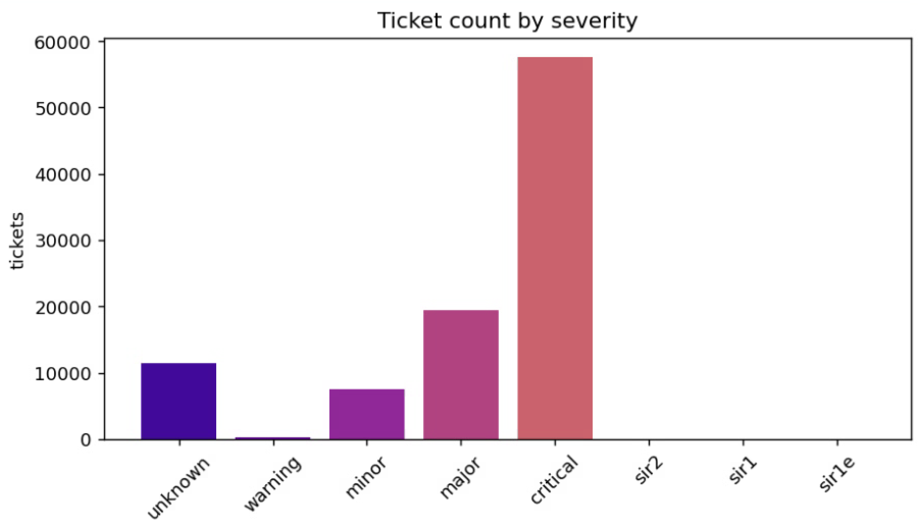
Ticket severity distribution (ticket sample: after 2026.01.01)

Slide 32
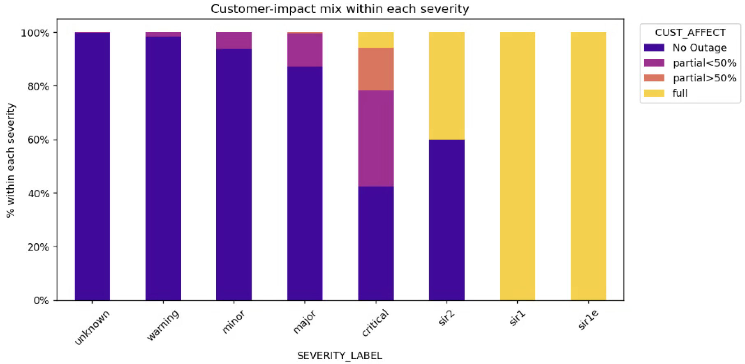
Ticket Outage Type distribution vs Severity

Slide 33
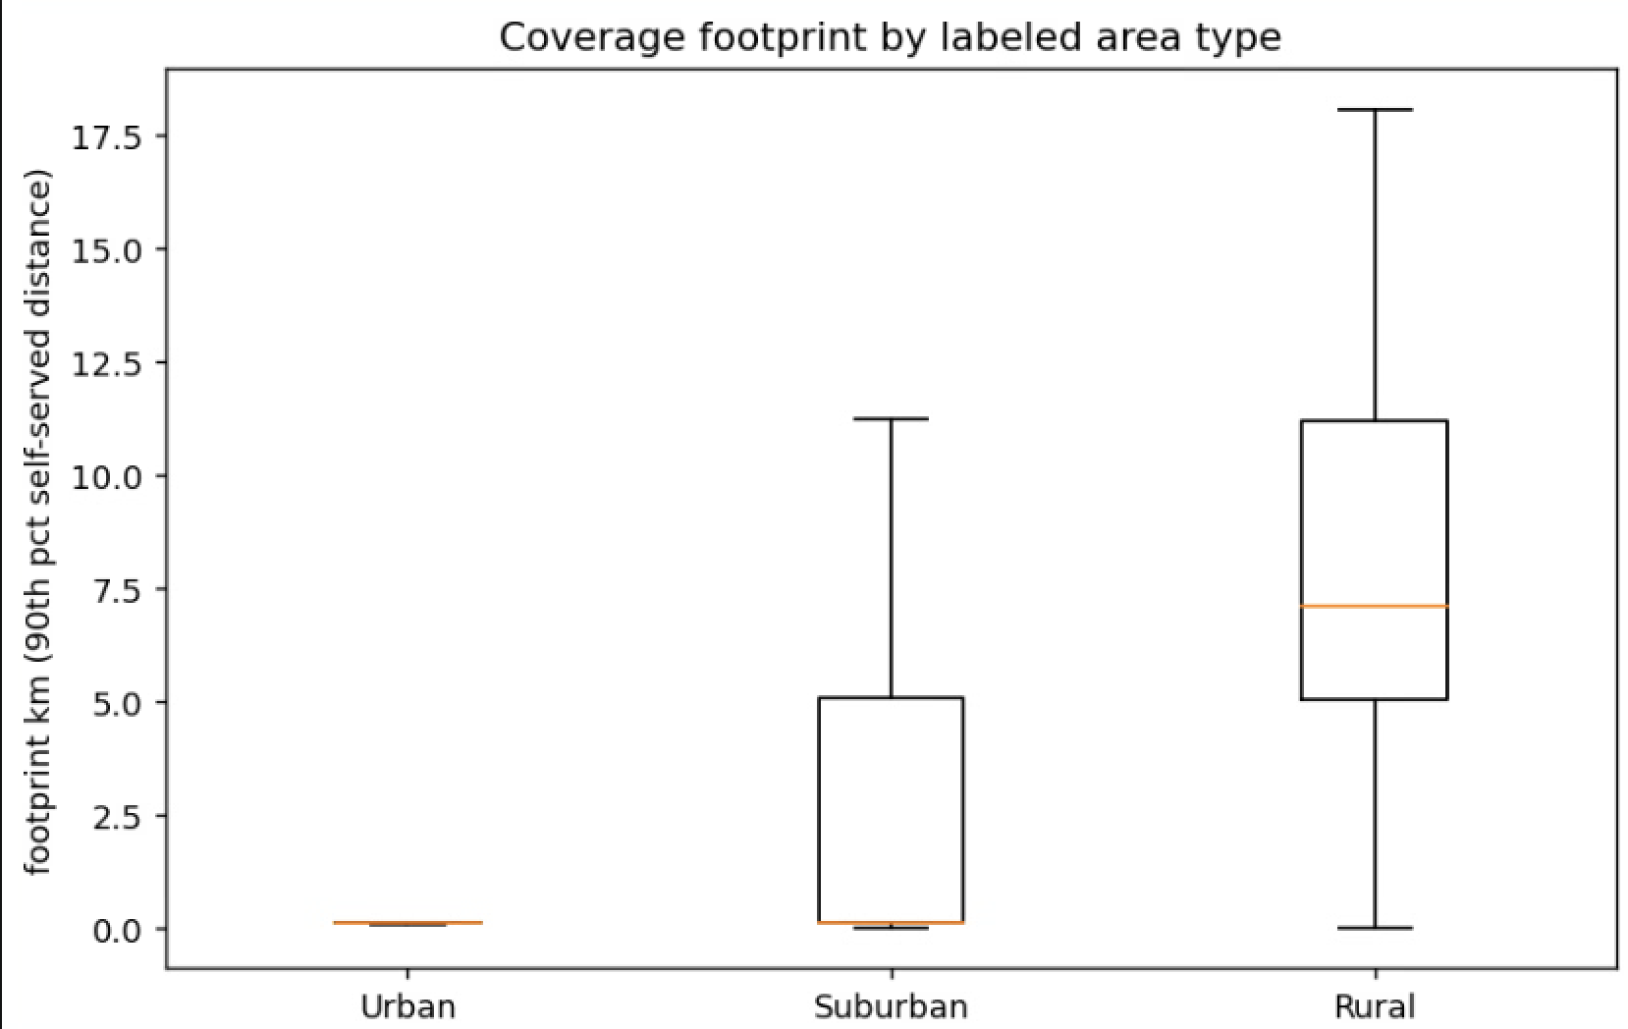
Coverage area for different type of station

Slide 34
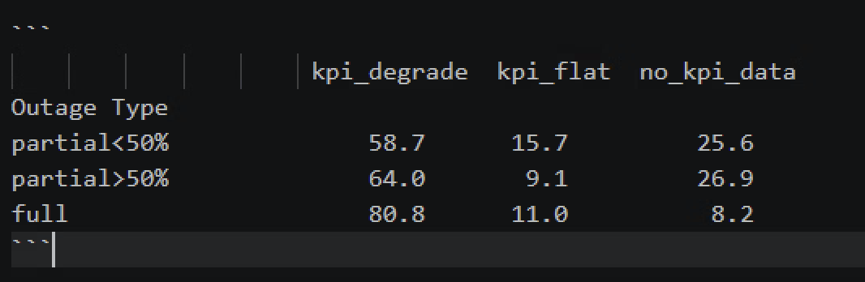
KPI data mismatch the outage type (full/partial)

Slide 35
Explorer stop schema
Outer loop
When all must-check dimensions are done, the Executor must decide: stop, or query another dimension?
Core question: would the output actually change if I queried another dimension?
small-LLM driven
For each unchecked dimension, run a 3-step probe with 3 samples
1
Generate worst-case hypothetical
2
Regenerate output under it
3
Compare critical fields
ASK THE LLM
WE ASK THE LLM
WE ASK THE LLM
"Imagine the most plausible finding for this dimension that would push severity higher. Be specific — give concrete values, named entities."
"Given the current draft output and this hypothetical finding as new evidence, rewrite the output. Use the same schema."
"Compare original vs counterfactual output. Did any of these critical fields change: severity, recommended urgency, regulatory trigger?"
WE GET BACK
WE GET BACK
WE GET BACK
A short hypothetical finding (natural language + concrete evidence).
A counterfactual output that incorporates the hypothetical.
Binary verdict per critical field — changed or unchanged.
Inner loop
Each dimension's inner loop has the Executor query data from coarse to fine and produce an analysis report carrying this dimension's severity level. It stops when the level converges — querying finer no longer changes the verdict.
Stop when the severity level is unchanged across two consecutive finer-grained queries.
ReAct agent decision
HOW THE LOOP RUNS
1
Query one granularity step
2
Re-derive the severity level
3
Compare with the previous step
Coverage: finer spatial sampling. KPI: longer time-series / more neighbors. Sensitivity: finer POI detail. Start coarse (Planner's starting_granularity).
From the evidence gathered so far, the Executor produces / updates this dimension's severity level for the analysis report.
Did the level change vs the last, coarser query? If yes → go finer (loop). If unchanged twice in a row → converged, stop.

Slide 36
Planner design
INPUT
OUTPUT — investigation strategy
Case metadata
case characterisation
Static attributes: band, tower height, site type, operator
Environment probing: land use, neighbor topology, network role
History, data availability flags, KPI metadata
1–2 sentences of typological framing (urban / peak / sole-coverage flags, etc.), one part of prompt
Planner
LLM-as-reasoning, one-shot
dimension strategy
For each selected dimension:
Dimension catalog
case → dimension selection
→ per-dimension config
priority, must_check flag, expected cost
rationale (Planner's reasoning trace)
candidate_tools — Executor's tool pool
specific_instruction — case-conditional hints
finding_schema — required output fields
coverage, capacity, sensitivity, temporal context
Tool registry
Tool name, input/output schema, description
WHAT THE EXECUTOR ACTUALLY SEES IN ITS REACT PROMPT
case characterisation — constant across turns, prevents framing reconstruction dimension goal & finding schema — defines what must be filled with evidence to terminate inner loop
candidate_tools — scoped tool pool (data fetching and preprocessing happen here) specific_instruction — case-conditional NL hints (filtering, thresholds, fallbacks)
budget — maximum tool calls for this dimension; harness enforces hard cap

Slide 37
Dimensions:
Coverage: coverage area/ coverage hole
Capacity: backup sufficient for handover
Sensitive: touch the sensitive infrastructure?
Timing: peak hour will add more heavy load
Service degrade: 5G->4G?
Tools for each dimensions:
input: query, fix form: usid, full/partial, time duration,
Sep1: urban/suburban.
Output: severity level and justify. (fine-grained) weather? Output form picture?

Slide 38
Updated plan
Until 6.4 finish the coding for the planner and executor, run a full pipeline in several set of real data, test how every component works, confirm the components. (check if the planner can successfully give guidance in different cases, test if the executor works when there are data missing)
6.4-6.18 run pipeline in a batch of data, refine and confirm the design of reflector. (test if the reflector should learn the lesson from the fail cases, and updated the skills. ), testing the batch size. Finish the tool, MCP server, coding.
6.18-7.1 finish the test of the whole pipeline based on large dataset (the ground truth ticket will be separated to train/val/test set)

Slide 39
KPI Agent (LLM — Temporal Reasoning)
Why LLM: This is a what-if question. The outage window is in the future — we have no KPI data for it. The agent must reason from 60 days of historical patterns to predict what will happen. This temporal inference requires contextual judgment, not a formula.
Input
Output <analysis>
60-day historical KPI timeseries — target site + all backup sites
15-minute granularity: throughput DL/UL, volume DL/UL per sector
Outage time window: start_utc, end_utc
Reference document — domain benchmarks for KPI interpretation
typical_traffic_level historical characterization of r0 at this time window
backup_historical_load historical load of each backup in the same window
overflow_risk_reasoning inference about whether backups can absorb r0's traffic
peak_hour_overlap whether outage window hits historically high-traffic periods
What the Agent Reasons About
confidence low / medium / high
Reasons about the predicted traffic impact and overflow risk during the future outage window, based on historical patterns.
flags.unresolved what historical data cannot tell us
KPI Evaluator — 4 Dimensions
1. Evidence Grounding — claims cite specific historical data points
2. Logical Consistency — predictions follow from cited patterns
3. Temporal Reasoning — correct use of time-of-day, day-of-week
4. Uncertainty Acknowledgment — limits of prediction properly flagged
Evaluator: LLM-as-Judges, ref: Agent GPA from snowflake

Slide 40
Coverage Preprocessing (Rule-Based, No agent)
How many users lost signal? → coverage hole fraction
How much signal quality was lost? → RSRP/SINR/throughput drop statistics
Is there a substitute signal? → per-backup absorption fraction and RSRP in absorbed zone
Where did the impact fall? → geographic intersection of coverage maps and real map
Post-Outage Simulation
Coverage Hole Metrics Threshold: RSRP<-110dBm (from 3GPP)
To be confirmed: Can be get from Rhea API/ computed from existing Rhea data
coverage_hole_count , fraction
coverage_hole_coords: [{lat, lon}] for map generation
affected_coordinate_count + total_coordinate_count
Signal Statistics Output (per affected coordinate)
Per-Backup Absorption
RSRP before / after / drop → mean, p10, p50, p90
Newly absorbed pixel count/fraction
existing_dominant_count / fraction
rsrp_in_absorbed_area: {mean, p10, p50}
SINR before / after / drop → mean, p10, p50, p90
RSRQ before / after / drop → mean, p10, p50, p90
Geographic Overlay (OSM)
Throughput before / after / drop → mean, p10, p50, p90
get_area_profile at centroid: hospitals, schools, railway, major roads
coverage_hole_coords for spatial overlap check
Maps generated: RSRP drop · SINR drop · Throughput drop · Before/After dominant site · Coverage map + facilities overlay · Land use map

Slide 41
Attribute Preprocessing (Rule-Based, No agent)
Target Site (r0) Characteristics
Technology Downgrade Risk
Describes what was lost when r0 went down
Users may lose 5G → 4G service during the outage
4G / 5G cell count raw counts from attribute CSV
technology_downgrade (per backup):
True if r0 has 5G cells AND backup has 0 5G cells
tech_downgrade_affected_fraction (overall):
Weighted by newly_absorbed_fraction across all backups
Active bands Band_700, Band_1800, Band_2600, Band_3500
Tower height + type

Slide 42
Final Assessment Agent (LLM — Cross-Dimensional analysis)
Input
Output <analysis>
overall_severity low | moderate | high
Coverage
Reason about the severity with the multi-modal evidence
confidence low | medium | high
Signal drop stats (RSRP/SINR/RSRQ/TP)
conclusion free text
Coverage hole fraction + coords
Per-backup absorption fractions
key_findings [str]
Make the plan | do the analysis | write the output
flags.unresolved unresolved items
Sensitive facility overlap + 6 maps
Attribute
Evaluator — 4 Dimensions
frequency band count and technology count
Tech downgrade fraction
1. Plan Quality
Neighbor relation feasibility
2. Plan Adherence
KPI Agent
3. Logical Consistency
Overflow risk reasoning
4. Evidence Coverage
Historical traffic context
⚑ Human Review triggered if: confidence = "low" OR flags.unresolved has significant items OR Evaluator fails after retry

Slide 43
Preprocessing
Pure Python · No AI
Signal, Coverage & Structural Capacity
KPI Traffic Baselines
INPUTS
INPUTS
usid_coverage_pixels.json — pixel-level RSRP / SINR / RSRQ / throughput per tower
usid_attributes.csv — tower height, 4G/5G cell counts, active frequency bands
Hourly KPI CSVs per USID — timestamp, throughput_mbps, volume_gb
Shutdown start timestamp — determines historical cutoff
HOW IT WORKS
HOW IT WORKS
For every geographic pixel in the area, it calculates which tower dominates and how strong the signal is.
Scores each USID's structural capacity based on how many 4G/5G cells it has and how many frequency bands are active.
Calculate which backup USIDs absorb its pixels, how loaded they become, and where coverage holes appear.
Classifies every pixel's interference environment (whether SINR is limited by competing USIDs or by the environment itself)
Produces six spatial maps: RSRP heatmaps per neighbor, dominance maps, SINR map, throughput map, and signal quality map
For each tower, computes statistical summaries of historical load: median, 90th percentile, 99th percentile throughput and volume
Builds hourly traffic patterns — what the average load looks like at each hour of the day across all historical records
Builds weekly patterns — how load varies across days of the week on average
Calculates a utilization ratio: how heavily each tower is already loaded relative to its theoretical maximum capacity
▶ preprocessing stats file + 6 spatial image files
▶ KPI stats file

Slide 44
Stage 1 — Coverage & Load Analysis
Coverage & Load Agent
Call AI agent
Analyzes whether the backup network can physically absorb the target's users after shutdown — both signal quality and structural load capacity.
INPUTS
HOW IT WORKS
Preprocessing stats file → coverage_summary, load_redistribution
RSRP heatmap images (target + neighbors)
SINR map image
Playbook hot tier + Stage 1 warm tier
Reads the preprocessing statistics and RSRP maps to reason about the backup network's physical readiness
Assigns a role to each back up USIDs (e.g., dominant anchor, strong support, edge-limited) based on how much down USID dominant area it covers
Cross-checks those role assignments against the actual heatmap images to confirm the spatial pattern is consistent
For each backup tower, evaluates how much extra load it would absorb from the target's shutdown and whether that load would push it into overload
Produces an overall load redistribution verdict: adequate, strained, or overloaded based on the combined picture across all backups
Also flags what fraction of the target's area would be left with no backup coverage at all (coverage holes)
OUTPUT ▸ stage1 coverage load file
Per-USID role assignments with spatial validation
Per-backup load analysis: absorption, RSRP, load factor, overload risk
Overall load redistribution verdict (adequate / strained / overloaded)
Coverage hole fraction, assessment, and key spatial findings → forwarded to Stage 3
⚡ Runs in parallel with attribute analysis agent and KPI analysis agent

Slide 45
Stage 1 — Coverage & Load Analysis
Attribute Analysis Agent
Call AI agent
Classifies each tower's hardware profile and assesses 5G downgrade risk from the target's configuration.
INPUTS
HOW IT WORKS
preprocessing_stats.json → capacity_summary (pre-computed capacity scores, technology profiles), tower height, technology profile
Reads pre-computed capacity scores and raw hardware specs for the target tower and all backups
Classifies each tower's technology profile: how many 4G and 5G cells it has, which frequency bands are active
Assesses 5G downgrade risk: if the target tower has 5G cells but its backups do not, users currently on 5G would be forced onto 4G after the shutdown
Estimates what fraction of users would experience this downgrade, and how significant the service impact would be
Produces an overall capacity verdict for the backup network: adequate, constrained, or insufficient
OUTPUT ▸ stage2_attribute_config.json
Per-tower capacity scores and technology profiles
5G downgrade risk flag affected user fraction ·
Overall capacity verdict

Slide 46
Stage 1 — Coverage & Load Analysis
KPI Analysis Agent
Call AI agent
Classifies each tower's hardware profile and assesses 5G downgrade risk from the target's configuration.
INPUTS
HOW IT WORKS
preprocessing_stats.json → capacity_summary (pre-computed capacity scores, technology profiles), tower height, technology profile
Reads pre-computed capacity scores and raw hardware specs for the target tower and all backups
Classifies each tower's technology profile: how many 4G and 5G cells it has, which frequency bands are active
Assesses 5G downgrade risk: if the target tower has 5G cells but its backups do not, users currently on 5G would be forced onto 4G after the shutdown
Estimates what fraction of users would experience this downgrade, and how significant the service impact would be
Produces an overall capacity verdict for the backup network: adequate, constrained, or insufficient
OUTPUT ▸ stage2_attribute_config.json
Per-tower capacity scores and technology profiles
5G downgrade risk flag affected user fraction ·
Overall capacity verdict

Slide 47
The detailed input and output
Step/agent | input | output
Pre-process | Raw Rhea data (include RSRP, throughput, SINR, RSRQ), attribute | RSRP heatmaps, SINR map, dominance map, numerical truth: RSRP percentiles, dominance fractions, capacity scores, load redistribution(load factors, overload risks, coverage hole fraction, SINR regime fractions)
Coverage & load agent | Coverage summary, RSRP heatmap + dominance map (images), load redistribution, constrains & rules | Per-backup roles (dominant_anchor / strong_supporting / etc.) Per-backup overload risks Load redistribution verdict (underloaded / balanced / overloaded) Coverage hole assessment
Attribute analysis agent | Attribute, constrains & rules | Tower type (micro, macro, tall_macro based on height thresholds) Technology profile (4G only, 4G+5G NSA, 5G NR) 5G downgrade risk
Geo-correlation agent | RSRP heatmaps, SINR map, dominance map, real map, load_redistribution_verdict, per_backup_overload_risks | 2–5 impact zones, each with: signal condition, SINR regime, land use, critical infra flag, severity
Final assessment agent | Output from the previous steps, constrains & rules | Final user impact level (1–4)C1–C5 constraint results Final conclusion narrative
Numerical verification | 13 numerical items check | PASS/FAIL
Reasoning verification | 6 reasoning items check | PASS/FAIL
Reflector | Previous step output | Updated rules about where the pipeline's reasoning was uncertain or wrong, so future runs handle similar edge cases better.

Slide 48
Constrains and rules (initial)
Level 1 — Minimal: The network handles the shutdown well — few holes, no critical sites, backups are strong and not overloaded — so most users feel nothing.
Level 2 — Noticeable: Something is imperfect — either coverage holes affect a moderate area, backup signal quality is only partial, or load is building — so some users experience degraded service.
Level 3 — Significant: At least one serious problem exists — either a large portion of the area loses coverage, a hospital or highway is affected, or backups are at high risk of congestion — making the impact impossible to ignore.
Level 4 — Severe: Multiple serious problems occur together — large holes, critical infrastructure affected, and backups already overwhelmed — causing widespread failure across the area.
C1: If the network has good redundancy (few holes and no overloaded backups), it caps the final level at 2 because a well-covered network cannot credibly produce a severe outcome.
C2: If any zone contains critical infrastructure like a hospital or major highway, it floors the final level at 3 because the consequences there are too serious to be softened by good conditions elsewhere.
C3: If most of the target area is interference-limited (backups nearly as strong as the target), it reduces the level by 1 because the majority of users will experience a smooth handover with minimal impact.
C4: If the backup network is already overloaded before the shutdown, it increases the level by 1 because absorbing extra traffic on top of an already-stressed network makes every outcome worse.
C5: If more than 20% of users will be forced from 5G down to 4G, it adds a 5G downgrade flag to the report without changing the level, because this specific consequence needs to be explicitly visible to the engineer.

Slide 49
Verification rules
V1: Target USID's RSRP p50 cited by Stage 1 matches preprocessing (±2 dBm).
V2: Coverage hole fraction cited by Stage 1 matches preprocessing (±0.01).
V3: Per-backup RSRP values cited by Stage 1 match preprocessing (±2 dBm).
V4: Per-backup load factors cited by Stage 1 match preprocessing (±0.05).
V5: Per-backup absorption fractions cited by Stage 1 match preprocessing (±0.05).
V6: Capacity score cited by Stage 1 matches preprocessing formula (±0.5).
V7: Capacity score cited by Stage 2 matches preprocessing formula (±0.5).
V8: NSA 5G affected fraction cited by Stage 2 matches preprocessing (±0.01).
V9: SINR fractions cited by Stage 3 match preprocessing (±0.05).
V10: All stages read the same preprocessing file version (sha256 hash match).
V11: C1 was applied correctly — level capped at 2 if and only if both conditions met.
V12: C2 was applied correctly — level floored at 3 if any critical infrastructure zone exists.
V13: C5 was applied correctly — 5G downgrade flagged if and only if both conditions met.
V14: Each zone's impact_severity correctly follows the rule table given its signal, land use, SINR regime, and load.
V15: Final level is consistent with all zone severities and constraints applied in the correct order.
V16: Stage 1's role assignments are justified by the dominance fractions and RSRP values it cited.
V17: Every Stage 3 zone cites specific image and map evidence.
V18: Stage 4's written conclusion matches its numeric level and constraint results.
V19: The full chain from Stage 3 zones through constraints to Stage 4's final level is coherent end-to-end.

Slide 50
Updated rules (possible examples)
Constraint interaction pattern: When C2 and C4 both fire simultaneously, apply C2 floor first, then check if C4 increment changes the result — never sum them independently.
C1/C2 mutual exclusion: When both C1 and C2 conditions are technically met, C2 always takes priority — C1 can never override a critical infrastructure floor.
Ground truth mismatch lesson: When a run's prediction was wrong against ground truth, records which constraints fired and which were missed so future runs apply them more carefully in similar network conditions.

Slide 52
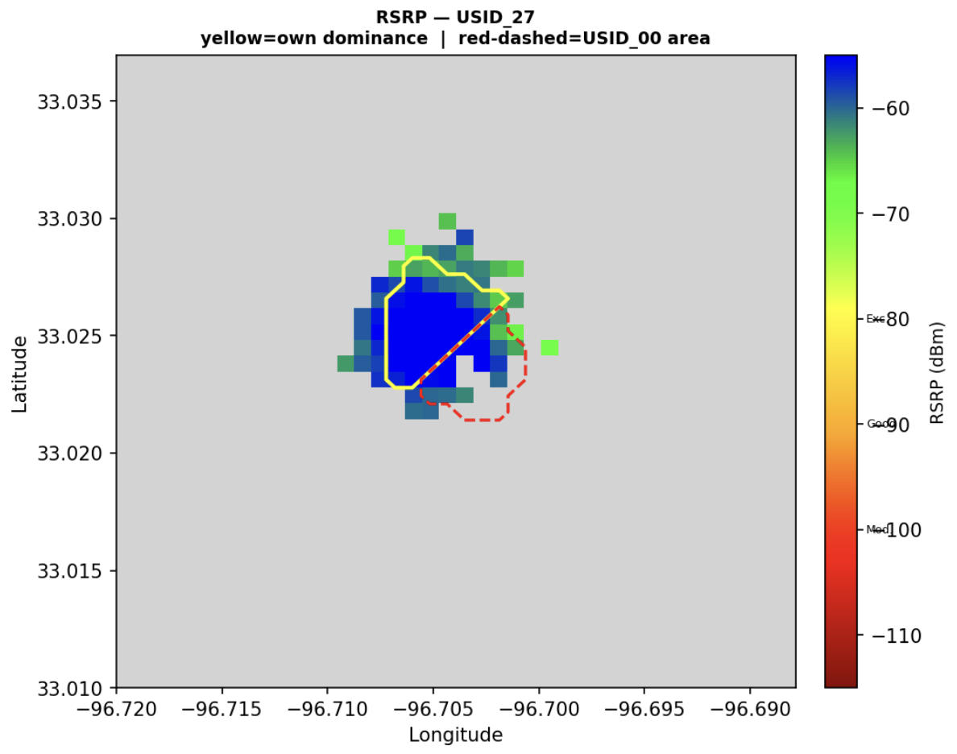
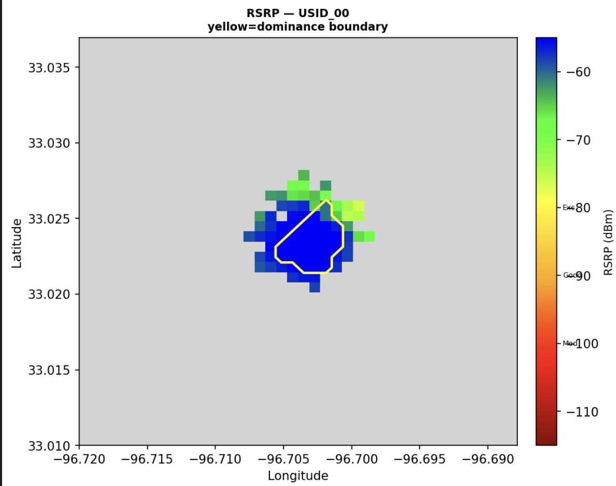
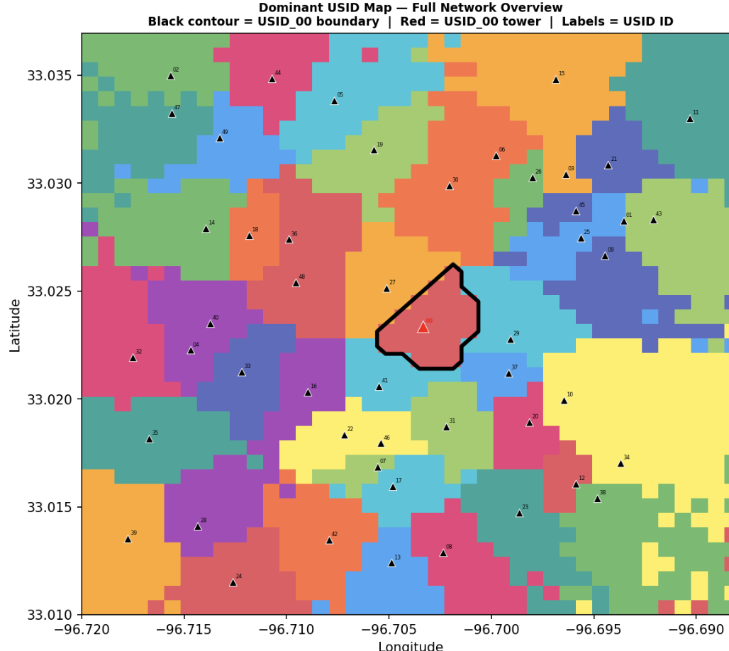
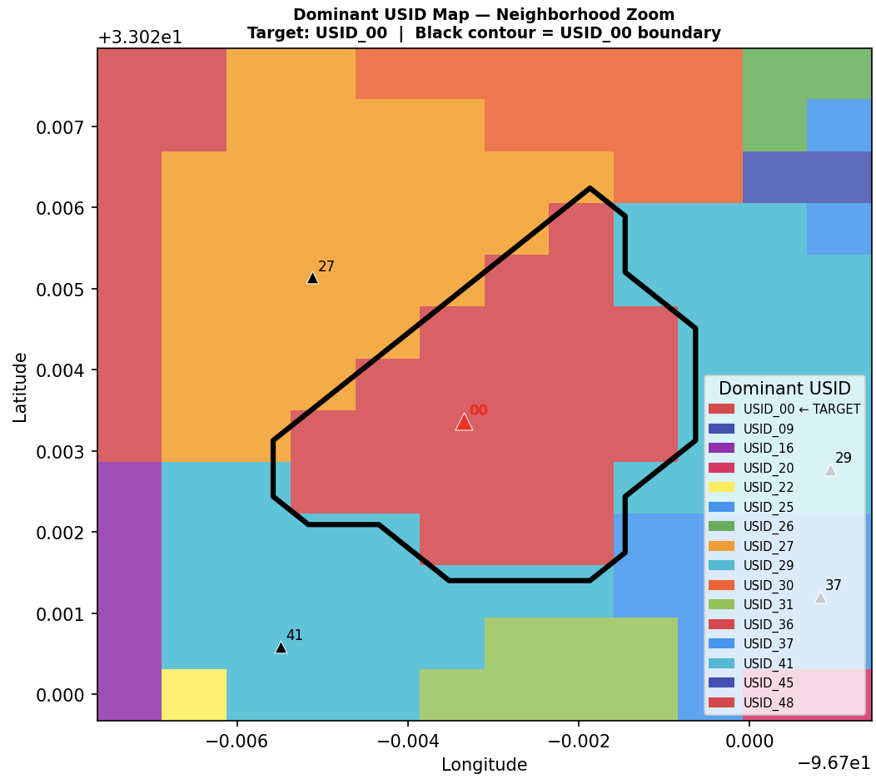
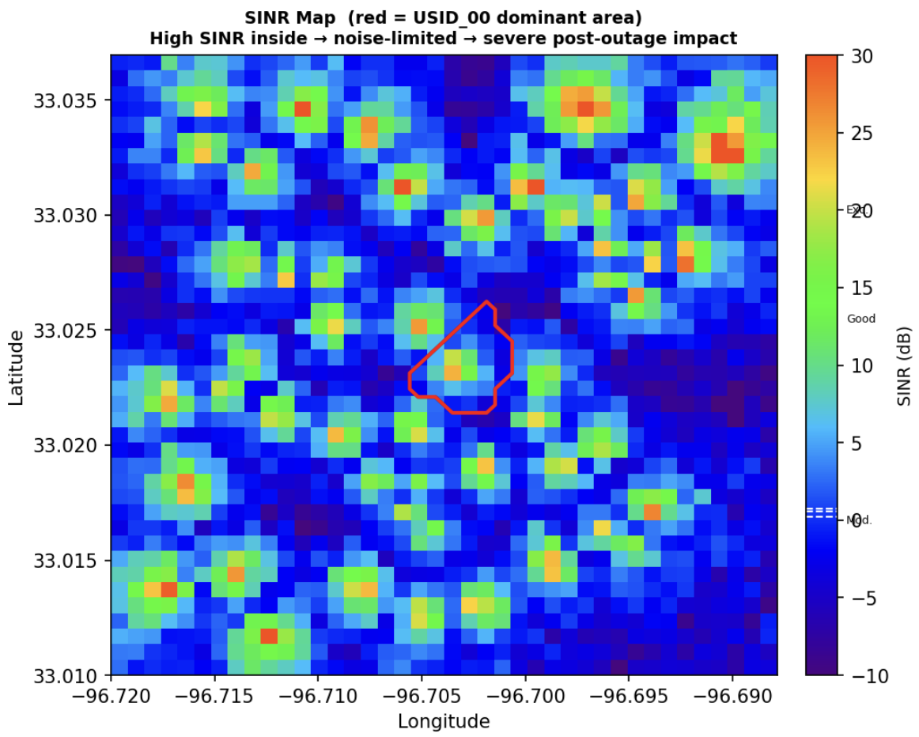
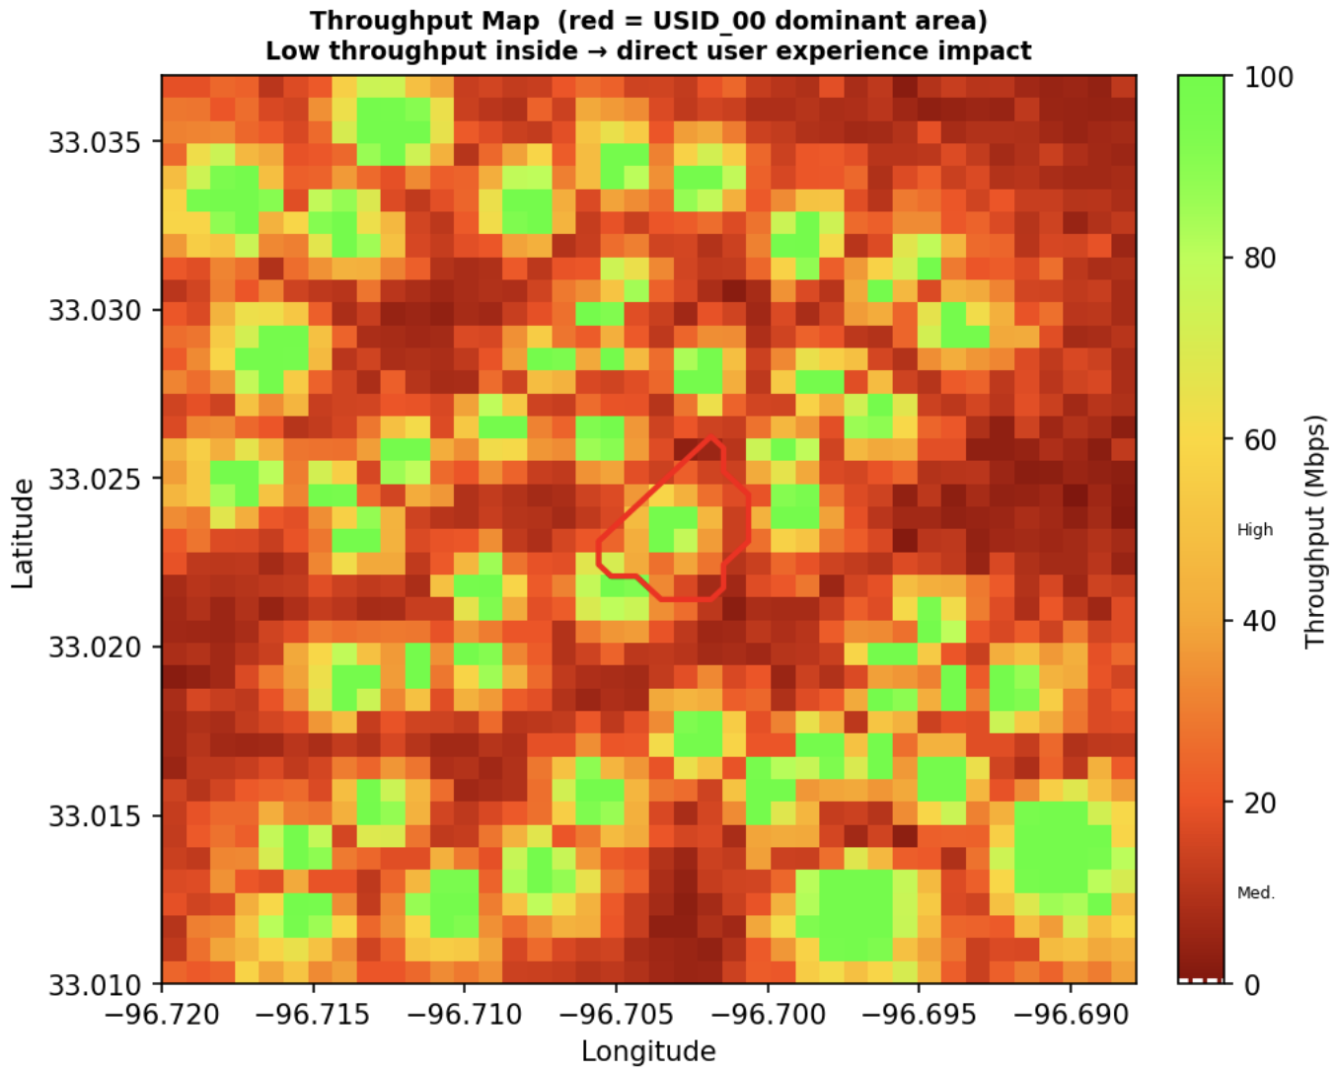
Preprocess output example
Numerical facts:
Coverage summary per USID:
Each tower's RSRP statistics (mean, p10, p50, p90) — how strong its signal is across its coverage area
Dominant vs backup pixel counts — how much area it "owns" vs where it just assists
Inferred role (edge-limited, localized-supporting) — how important it is to the network
Capacity summary per USID:
Tower height and type (micro / macro / tall_macro)
4G/5G cell counts and technology profile
Pre-computed capacity score — Python calculated this so agents never recompute it
Overlap info:
Overlap fraction — how much of USID_00's area each neighbor already covers
Is neighbor flag — identifies the 5 direct handover candidates
Load redistribution:
Coverage hole fraction — pixels with no viable backup (11.5% here)
SINR regime of target's dominant area — mostly_mild means low interference
Per-backup breakdown — for each of the 5 neighbors:
How many pixels it absorbs and what fraction that represents
Signal quality in those absorbed pixels (RSRP p50, handover quality)
Post-outage load factor and overload risk — will it be overwhelmed?
Hard/easy gap fractions — how smoothly users can hand over

Slide 53
Stage0: Local Pre-process
Input data:
Rhea data json file, Attribute, real map
Output:
Rsrp pictures (only draw the target USID and its neighbors)
Dominant pictures: draw all USID’s dominance area in one picture without color difference, and draw the colored dominance area picture for the target USID and its neighbors.
Json file that include information that is not inside the RSRP pictures:
coverage_summary per_usid
Capacity score (calculate from the attribute, can be adjust), frequency count, tower height..
Overlap info
Load redistribution: estimate the load for the neighbors after the target USID is shut down. And if there is a large rsrp gap between the target USID and the backup USID

Slide 54
Stage1: Coverage and Load redistribution analysis
Input data:
coverage_summary.per_usid → role, fractions, RSRP stats
load_redistribution → per_backup absorption, handover, load, regime
overlap_info → which USIDs are neighbors
rsrp_USID_XX.png → spatial pattern of each USID
sinr_map.png → SINR environment
Output:
role Read directly from coverage_summary.per_usid[usid].inferred_role — not re-determined by the agent. Agent must cite it exactly.
role_confidence Agent determines based on rules in SKILL.md:
high: dom_frac ≥ 0.15 AND rsrp_p50 ≥ -90 dBm low: dom_frac < 0.05 OR rsrp_p50 < -100 dBm medium: everything else
dominant_pixel_fraction: Read directly from coverage_summary.per_used
rsrp_p50_dbm : Read directly from coverage_summary.per_used
rsrp_spatial_pattern Agent-generated from RSRP image — compass direction description of where signal is strong vs weak. This is the one field that cannot be pre-computed locally — it requires reading the image.
Example: "USID_31 dominance (yellow boundary) is clearly to the S/SW, well below USID_00's territory (red-dashed entirely above USID_31's dominance). Only the very southern tip of USID_00's dominance overlaps with USID_31 coverage. In that narrow southern overlap zone, signal is Excellent (blue, p50_in_zone=-57.54 dBm). USID_31 contributes minimally to coverage of USID_00's area (7.7% absorption)."
dominant_area_impact_regime Read directly from load_redistribution.dominant_area_impact_regime in preprocessing.
coverage_hole_fraction Read directly from load_redistribution.coverage_hole_fraction.
load_redistribution_verdict Agent determines from all per-backup data combined
OVERLOADED: coverage_hole_fraction > 0.20 OR any overload_risk = "high” OR sum(absorption_fractions) < 0.60 OR majority handover_quality = "poor"
STRAINED: coverage_hole_fraction 0.05-0.20 OR any overload_risk = "medium” OR majority handover_quality = "partial"
ADEQUATE: coverage_hole_fraction < 0.05 AND all overload_risk = "low” AND majority handover_quality = "good"
"USID_00 RSRP is uniformly Excellent (p50=-57.0 dBm, 100% above -80 dBm) within its compact dominance boundary — no signal-weak zones exist inside the yellow contour.",
"Coverage holes (11.54%) are confined to the southern fringe of the dominance area, visible as the gap between USID_00's southern boundary and the northern limit of USID_41/USID_37 coverage.",
"USID_27 provides the strongest backup presence, covering the NW-to-central portion of USID_00's area with Excellent (blue) signal in its zone.",
"USID_31 is spatially far to the S and contributes minimal coverage to USID_00's territory — its reach stops well short of the northern half of USID_00's dominance area."
key_findings_for_stage3

Slide 55
Stage 2: USID ATTRIBUTE ANALYSIS
Input data:
capacity_summary (from preprocess) → pre-computed scores, tower type, role, tech
usid_attributes.csv → raw band/cell/height data
Output:
capacity_score Read directly from capacity_summary — not recomputed.
tower_type, technology_profile, operational_role Read directly from capacity_summary — not recomputed.
key_observations Agent-generated interpretation of the band/height configuration
example: "5G-dominant profile with 6 5G cells and 4 4G cells across 4 bands (700, 1800, 2600, 3500 MHz) gives broad spectral coverage and strong NR capacity.",
"40m macro tower height provides good line-of-sight in suburban terrain but is not outstanding — within the standard macro range.",
"Capacity score 25.6 is among the highest in the network, reflecting the 5G-heavy cell mix weighted by the formula (4x1.0 + 6x2.0) x (1+0.15x4) = 25.60.",
"Mixed operational role reflects the combination of LTE coverage bands (700 MHz) and high-capacity NR bands (3500 MHz)."
5g down-grade risk.
If target has 5G_cells > 0 AND primary backup has 5G_cells = 0: flag it
estimate affected_fraction = (target_5G / (target_4G + target_5G)) × target_dominant_fraction
overall_capacity_verdict
adequate: all backup capacity_scores comfortably above load requirement
constrained: some backups have low capacity scores relative to absorbed load
insufficient: capacity scores too low to handle redistribution
capacity_verdict_reasoning
"Post-outage load factors are all below 0.015 — orders of magnitude below the 0.5 medium-risk threshold — confirming that the capacity of each backup remains virtually unperturbed by USID_00's shutdown.",
"USID_41's lower score (15.6) is a minor concern in isolation, but its post-outage load factor of 0.012 shows trivial incremental load, so its capacity is not a binding constraint.",
"5G continuity is ensured across the network — no backup USID drops to 4G-only, preserving NR service for all USID_00 users post-handover."

Slide 56
Stage 3: Geographic correlation analysis
Input data:
load_redistribution, overlap_info → pre-computed and stored in pre-process json file
load_redistribution_verdict, per_backup_overload_risk→ stored in stage 1 output file
All images
Output:
geographic_character: Agent determines from real map: urban/suburban/rural/mixed based on visible building density, road patterns, open space.
impact_zones Each zone identified by agent from correlating RSRP image with real map. Every field in each zone:
signal_condition: agent maps RSRP to strong/moderate/weak/very_weak using thresholds from REFERENCE THRESHOLDS
sinr_regime: agent reads from SINR map which zone is noise_limited/interference_limited (check the environment noise and if the back up is strong)
land_use: agent identifies from real map — hospital/commercial/residential/road/industrial/forest/water/uncertain
is_critical_infrastructure: agent flags if land_use is hospital/emergency/transit hub
impact_severity: agent combines signal + SINR + land_use + load:
coverage_hole_geographic_assessment:
"hole_fraction": 0.1154,
"hole_location_description": "Grey pixels visible at the S/SW fringe of the USID_00 RSRP image, just outside and partially overlapping the southern edge of the yellow dominance boundary. These 3 pixels represent the southernmost portion of USID_00's dominant area where none of the five neighbor USIDs (USID_27 NW, USID_29 ESE, USID_41 S, USID_37 SE, USID_31 S) extend sufficient signal.",
"land_use_in_hole_area": "residential",
"user_impact_of_holes": "high”
key_findings_for_stage4
"The 11.54% coverage hole (3 pixels) is located at the S/SW residential edge of USID_00's boundary — these residents will have no handover target during the 4-hour shutdown window, representing the primary user-facing impact.",
"88.46% of USID_00's dominant area is covered by backup USIDs with strong signal (all in-zone RSRP > -57 dBm), interference-limited SINR regime, and negligible load impact — impact is negligible for the vast majority of affected users.",
"No critical infrastructure (hospital, major highway/expressway) was identified in or adjacent to USID_00's dominance area from the real map; there is no critical severity escalation driver.",
"The suburban residential character throughout the target area means user_relevance is uniformly high — all residents in the 11.54% hole area will experience complete coverage loss, while the remaining 88.46% will experience a transparent handover.",
"The predominantly interference-limited SINR regime (69.2% low SINR) within the target area means backup signals were already competitive pre-outage, confirming the mostly_mild impact character for covered zones."

Slide 57
Stage 4: FINAL INTEGRATED ASSESSMENT
Input data:
stage1_coverage_load.json → full Stage 1 output
stage2_attribute_config.json → full Stage 2 output
stage3_geographic.json → full Stage 3 output
shutdown_start, shutdown_end → from user input
Output:
user_impact_level (1-4) Agent determines from all stage inputs applying hard constraints:
Level 1 (Minimal): holes < 5%, no critical infra, adequate backup, low load
Level 2 (Noticeable): holes 5-20% OR partial backup OR medium load
Level 3 (Significant): holes > 20% OR critical infra OR high load
Level 4 (Severe): multiple: large holes + critical infra + overloaded backups
impact_breakdown fields Agent splits the overall impact into four risk dimensions:
radio_degradation_risk: driven by coverage holes and RSRP quality drop
service_degradation_risk: driven by throughput impact and SINR regime
user_facing_impact_risk: driven by geographic land use relevance
load_redistribution_risk: driven by overload risk of backups
5g_downgrade_risk: from Stage 2 flag

Slide 58
Stage 5: FINAL INTEGRATED ASSESSMENT
Input:
preprocessing_stats.json → ground truth for all numeric checks
stage1_coverage_load.json
stage2_attribute_config.json
stage3_geographic.json
stage4_final_USID_XX.json
Output:
V1-V4 (coverage role checks) Deterministic comparisons against preprocessing ground truth with tolerance bands — e.g. V2 checks |cited_fraction - precomputed_fraction| ≤ 0.01.
V5-V8 (load redistribution checks) V7 is the most important: checks that overload_risk labels exactly match the load factor thresholds defined in preprocessing. If agent cited "medium" but load_factor=0.82 (which should be "high"), V7 FAILs.
V9-V10 (capacity checks) V9 checks capacity scores within ±0.5 of precomputed values. V10 checks tower type matches height rules exactly.
V11-V14 (constraint checks) Verifies each hard constraint was applied correctly in Stage 4 when it should have been triggered.
V15 (consistency check) Subjective — agent judges whether Stage 4 level is consistent with Stage 1 + Stage 3 combined evidence. The only non-deterministic check in Stage 5.

Slide 59
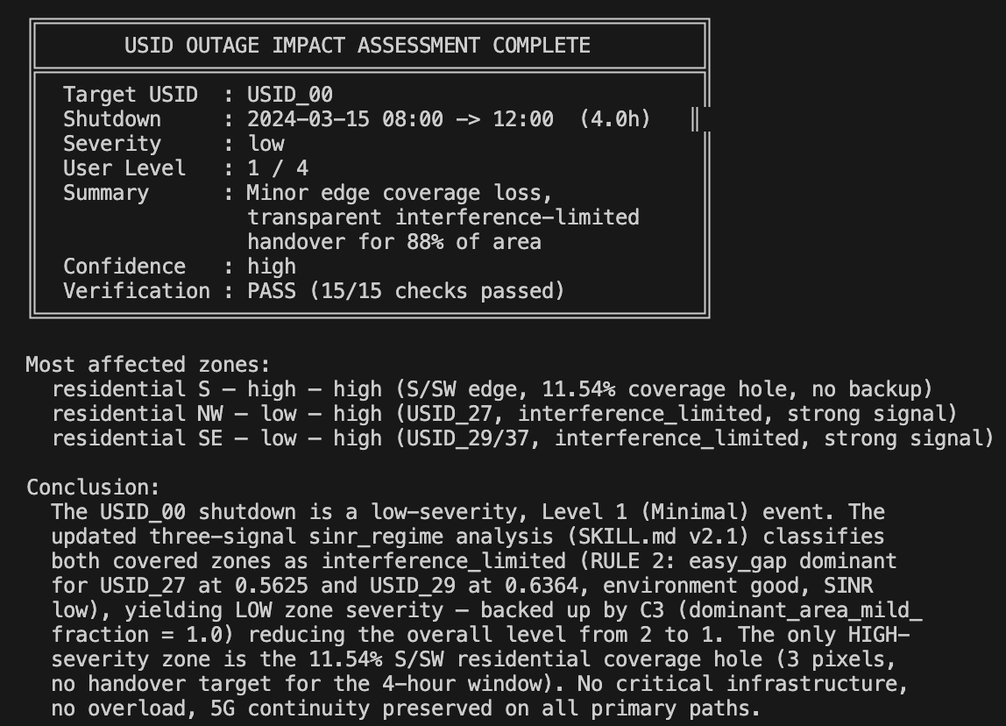
FINAL OUTPUT

Slide 60
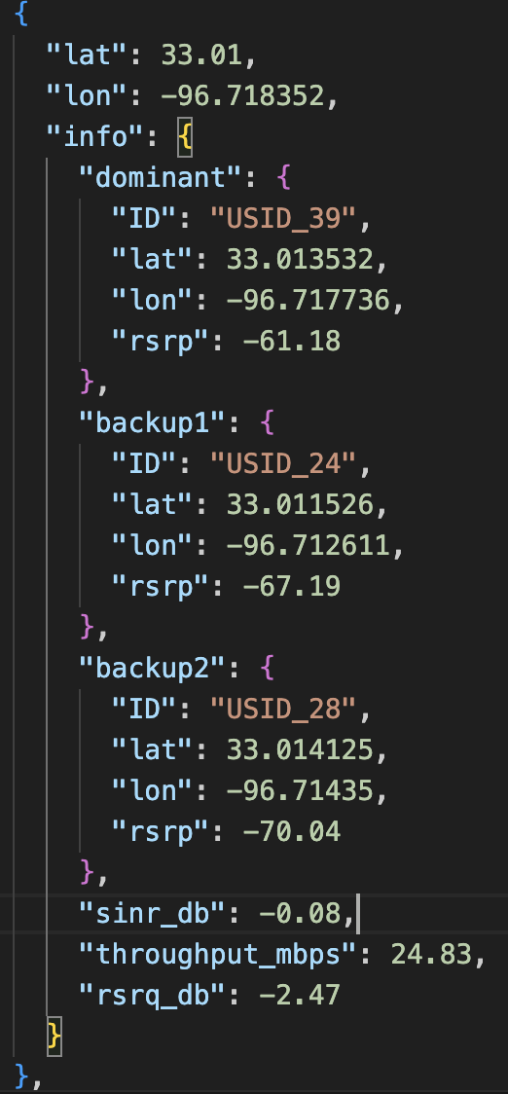
Stage0: Local Pre-process
Input data:
Rhea data json file, Attribute, real map
Output:
Rsrp pictures (only draw the target USID and its neighbors)
Dominant pictures: draw all USID’s dominance area in one picture without color difference, and draw the colored dominance area picture for the target USID and its neighbors.
Json file that include information that is not inside the RSRP pictures:
The dominance coverage size percentage for every USID, the rsrp strength statistics for every USID, the overlapping percentage
Capacity score (calculate from the attribute, can be adjust), frequency count, tower height..
Load redistribution analysis: each back up USID will take how many area (before and after shut down); will the back up USID have heavy load after target USID shut down.

Slide 61
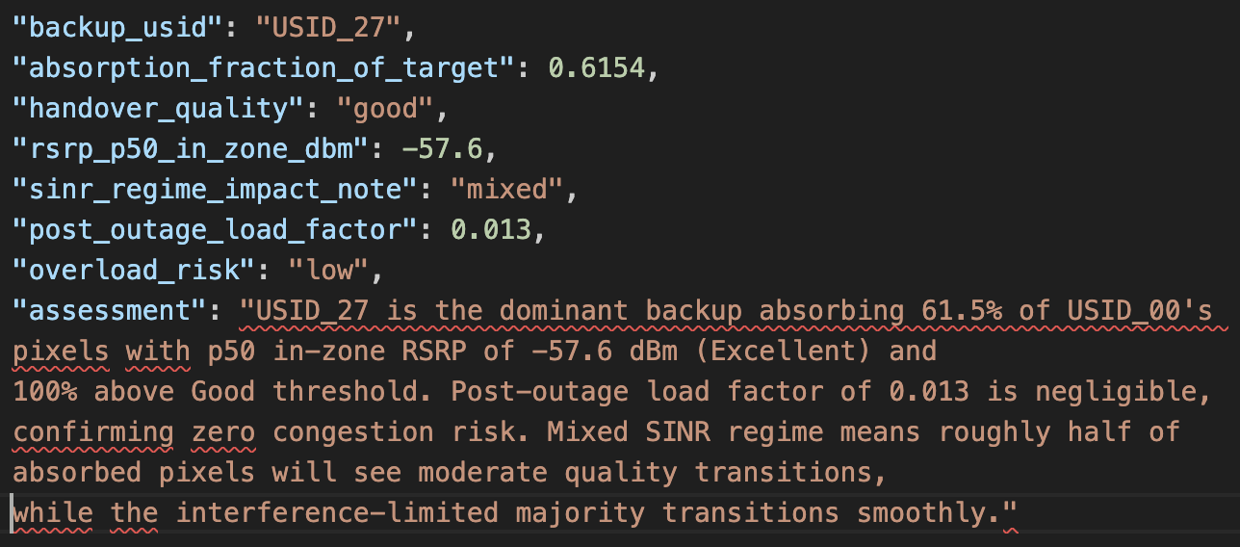
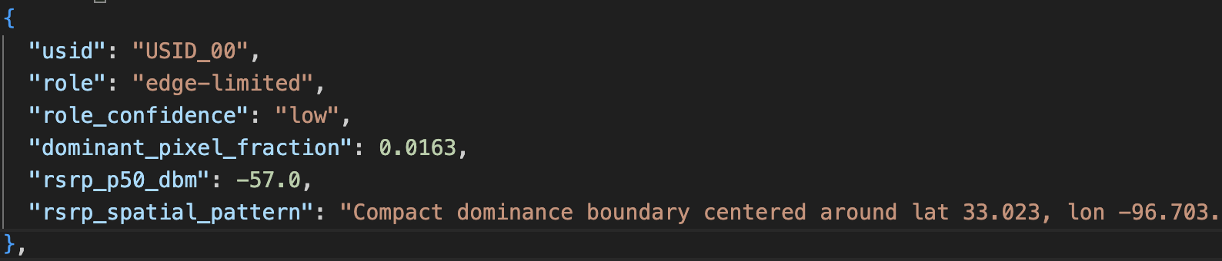
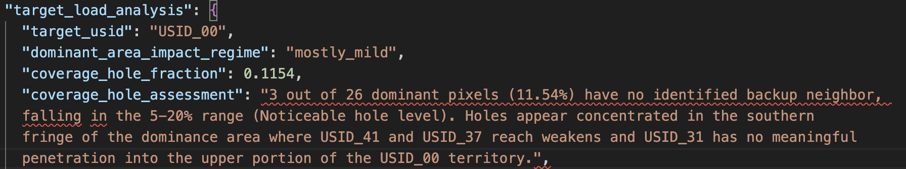
Stage 1: Coverage and Load redistribution analysis
Output:
1.Target USID and its neighbors description:
role: dominance_fraction > 30%: dominant-anchor, 10-30%: strong-supporting
3-10%: local supporting, <3%: edge_limited
Role confidence:
Confidence = high if dom_frac >= 0.15 AND rsrp_p50 >= -90 dBm
Confidence = low if dom_frac < 0.05 OR rsrp_p50 < -100 dBm
2.target USID coverage analysis:
3. Back up USID analysis
Handover quality:
Calculate the absorbed pixels that rsrp >-90dmb percentage
Sinr_regime_impact_note: RSRP gaps between the backup USID and the target USID
Post_outage_load_factor: the overload possibility (now estimated by the original pixels and pixels after shut down)
if high_sinr_frac > 0.5: impact_regime = "mostly_severe"
elif low_sinr_frac > 0.5: impact_regime = "mostly_mild"
else: impact_regime = "mixed"

Slide 62
Stage 2: USID ATTRIBUTE ANALYSIS
Output:
1. From preprocess json file:
Capacity score (from preprocess part, need to be determined later)
(4G_cells × W4G + 5G_cells × W5G) × (1 + BAND_BONUS × active_bands)
Tower type: depends on the tower height:
if height < 25: tower_type = "micro"
elif height <= 45: tower_type = "macro"
else: tower_type = "tall_macro
……
2. 5g down-grade risk.
If target has 5G_cells > 0 AND primary backup has 5G_cells = 0: flag it
estimate affected_fraction = (target_5G / (target_4G + target_5G)) × target_dominant_fraction

Slide 63

Stage 4e
FINAL RESULT
DOMINANCE & RSRP SUMMARY
High dependence in central sector; limited overlap with neighboring USIDs.
Target USID:
XXX
Shutdown:
02:00 AM
SEVERITY: HIGH
ATTRIBUTE ANALYSIS
KEY REASONS
Macro site; 700MHz/1800MHz bands; Primary coverage role for residential corridor.
Strong local dependence
Limited fallback support
User-active urban area
MITIGATING FACTORS
Partial neighbor support
REGIONAL TARGET-AREA ANALYSIS
Weak baseline SINR in NW zone; high user density during shutdown window.

Slide 64
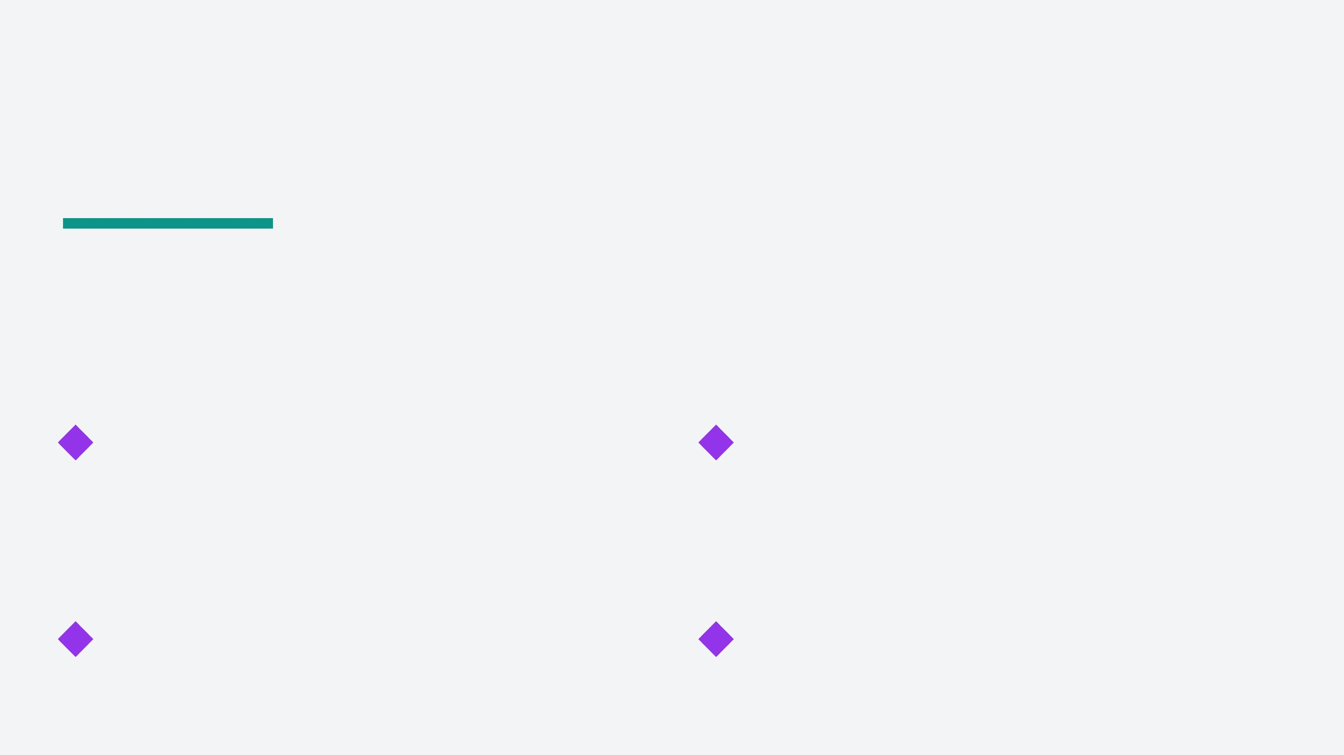
Challenges
Co-operation between More input Data
USER-FACING PRIORITY
Combines USID-level, attribute-level, and regional
Shifts focus from technical radio metrics to actual
evidence for a holistic assessment.
user experience and satisfaction.
OPERATIONAL PRECISION
CRITICAL FACTORS
Evaluates specific USID outages at fixed times for
Geography and user presence are essential for a
better network planning and maintenance.
calibrated and accurate impact assessment.
USID OUTAGE IMPACT ASSESSMENT FRAMEWORK © 2026

